Slide 1
Micro Credit Defaulter Project
Submitted By:
Vaibhav Garg

Slide 2
Problem Statement
MFI (Micro finance Institute) is an organization that offers financial services to low income population.
Telecom industry client is collaborating with MFI to provide micro credit on mobile balance which need to be paid back in 5 days.
Customer considered to be defaulter if he /she unable to pay back the loan amount within the time duration of 5 days.

Slide 3
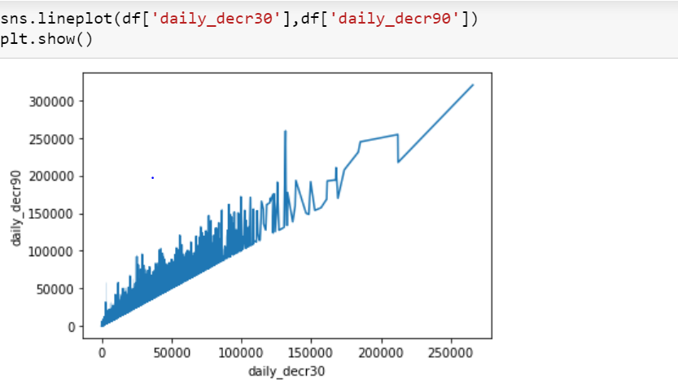
EDA And Data Visualization
We build a line plot through seaborn library in which we put Daily amount spent from main account ,averaged over last 30 days on x-axis and Daily amount spent from main account ,averaged over last 90 days on y-axis.
We can see in the image that both are directly proportional to each other.

Slide 4
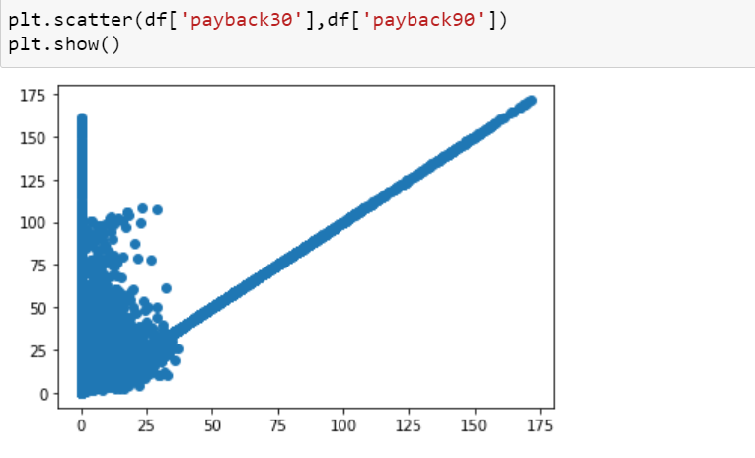
Here we are using Scatter plot through Matplot library in which we put average payback time in days over last 30 days on x-axis and average payback time in days over last 90 days on y-axis

Slide 5
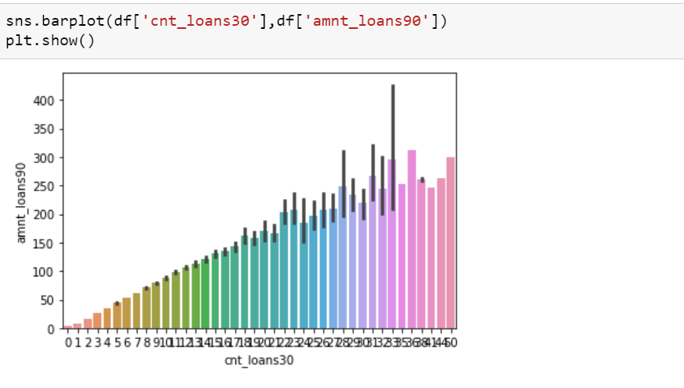
Here we use Bar plot through seaborn library.
We put number of loans taken by user in last 30 days on x-axis and total amount of loan taken by user in last 90 days on y- axis.

Slide 6
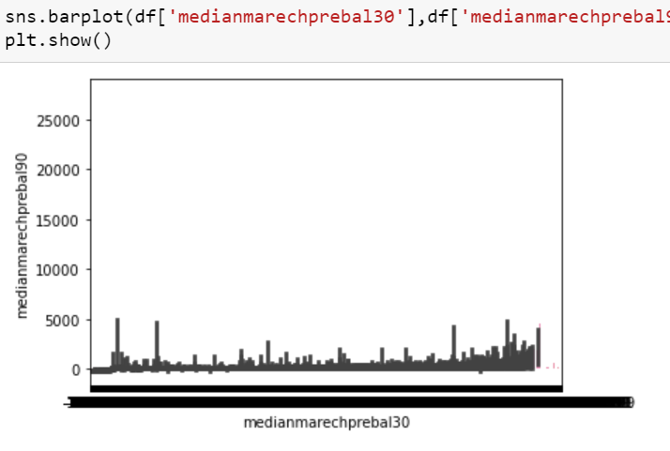
We are using Barplot through sns Seaborn library.
Here we are putting median of main account balance just before recharge in last 30 days at user level on x-axis and median of main account balance just before recharge in last 90 days at user level on y-axis.

Slide 7
Steps And Assumptions
In this project we have deleted some attributes that are not going to effect our target variable i.e. Label (A flag indicating that whether the user paid back the credit amount within 5 days of issuing the loan[1 : Success, 0: Failure])
Attributes deleted are:
Mobile number of the user
Telecom circle
Date
Age on cellular network in days

Slide 8
We checked for the outliers and found out that there are lots of outliers present in this dataset around 22% of the whole data.
But as we know data is very expensive and we can not afford to loose this much of data, therefore we changed value of Z=3 (standard value) to Z=5. Now after changing value, we are loosing around 8 percent of data.
We choose our Target variable (Y) and our Independent variable (X) to train our model accordingly.

Slide 9
Finalize model and conclusion
We train our dataset on different models and metrics
Models:
SVC(support Vector Classifier)
Decision tree classifier
K-Neighbors Classifier
Random Forest Classifier
Ada-Boost classifier
Gradient boosting Classifier

Slide 10
Metrics:
Accuracy Score
Confusion Matrix
Classification Report
After applying all the metrics and models, we can see that we are getting the best Accuracy score with random forest classifier. (Accuracy sore of 91.41% which is the best in all the models)
At last we concluded that in 91.4% cases we can find out that if we can provide loan to the individual or not.

